Slide 1
Path Aggregation Network for Instance Segmentation (PANet)
By - Devyash Parihar

Slide 2
Introduction
Architecture
Dataset preparation
Results
Targets

Slide 3
Introduction
This network is based on Mask R-CNN and the FPN frameworks while enhancing information propagation.
Bottom-up Path Augmentation is introduced to improve the propagation of features.
1st place in COCO Instance Segmentation Challenge 2017 and 2nd place in COCO Detection Challenge 2017.

Slide 4
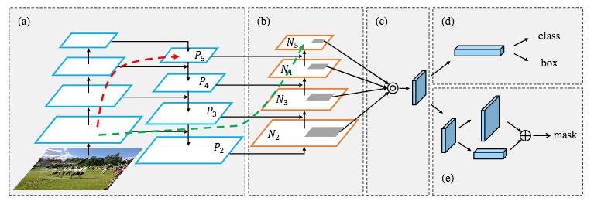
Architecture
(a): Feature extractor using the FPN architecture. (b): The new augmented bottom-up pathway added to the FPN. (c): The adaptive feature pooling layer. (d): bounding box and class prediction (e): The branch predicting the binary mask of the object.

Slide 5
Pooling : https://www.youtube.com/watch?v=ZjM_XQa5s6s

Slide 6
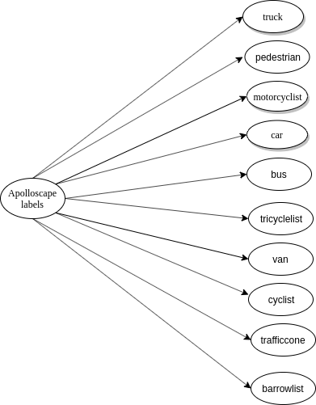
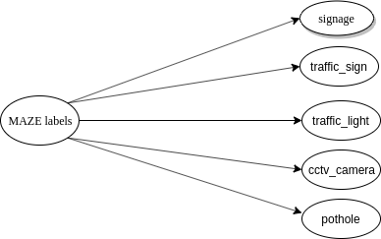
Dataset preparation
Maze ODS dataset
Apolloscape Obstacle Detection

Slide 7
Dataset preparation
I trained PANet on
COCO 2014 dataset
MAZE dataset
Apolloscape Obstacle detection (sample) dataset.
Both the datasets (MAZE and Apolloscape OD) had only about 100 images.
PANet uses COCO styled annotation format for training purpose.
I wrote 2 scripts:
To convert Apolloscape Obstacle detection annotations to COCO
To convert MAZE dataset(ODS Job) annotations to COCO
Framework used: PyTorch
YouTube link : https://www.youtube.com/watch?v=oBklltKXtDE

Slide 8
Results

Slide 9
Targets
To train PANet on same set of images as YOLO and calculate its mAP to compare the performances of the models.
To use Apolloscape Lane Segmentation dataset for training and extract road objects.

Slide 10
Thank You

